Slide 1
State Diagrams
Dmitriy Sinitsyn

Slide 2
What is a State Diagram?
A state diagram shows the behavior of classes in response to external stimuli. Specifically a state diagram describes the behavior of a single object in response to a series of events in a system. Sometimes it's also known as a Harel state chart or a state machine diagram. This UML diagram models the dynamic flow of control from state to state of a particular object within a system.

Slide 3
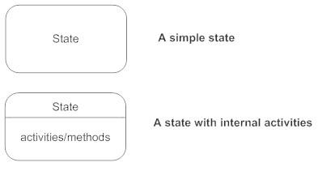
Basic State Chart Diagram Symbols and Notations
States
States represent situations during the life of an object. You can easily illustrate a state in SmartDraw by using a rectangle with rounded corners.

Slide 4


Basic State Chart Diagram Symbols and Notations
Transition
A solid arrow represents the path between different states of an object. Label the transition with the event that triggered it and the action that results from it. A state can have a transition that points back to itself.
Initial State
A filled circle followed by an arrow represents the object's initial state.
Final State
An arrow pointing to a filled circle nested inside another circle represents the object's final state.

Slide 5
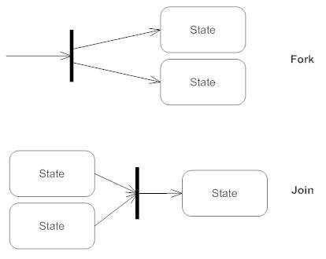
Basic State Chart Diagram Symbols and Notations
Synchronization and Splitting of Control
A short heavy bar with two transitions entering it represents a synchronization of control. The first bar is often called a fork where a single transition splits into concurrent multiple transitions. The second bar is called a join, where the concurrent transitions reduce back to one.

Slide 6
